Slide 1

Interactive Dashboard for Cross-Selling Recommendations
Group Name: Solo Analyst
Name: Munirah Alfehaid
Email:munirah9hamad@gmail.com
Country: Saudi Arabia
Specialization: Data Analyst

Slide 2
Introduction
I designed this dashboard with a focus on visualizing the key performance indicators (KPIs) that are critical to understanding customer segmentation and activity patterns. I used Figma for the initial design, which helped me focus on the overall structure and presentation before implementing it in Power BI for interactivity and deeper data insights.

Slide 3
Dashboard

Slide 4
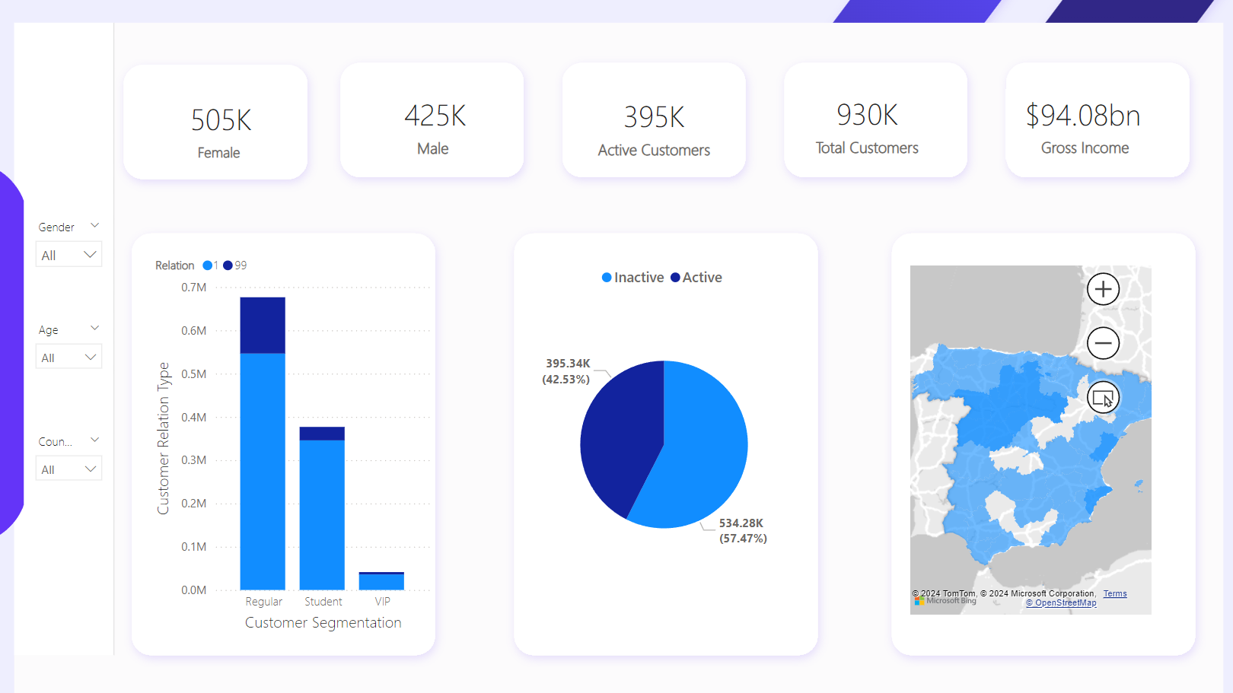

Slide 5
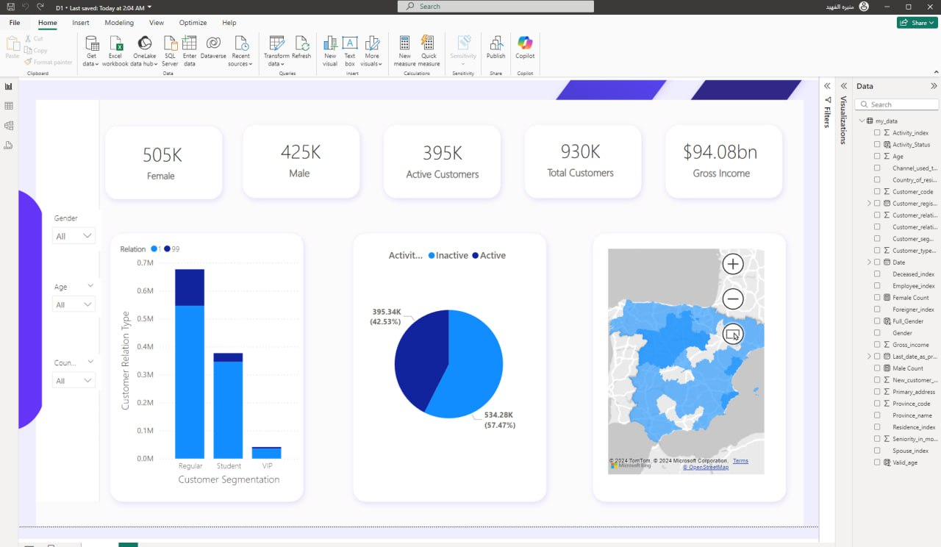

Slide 6
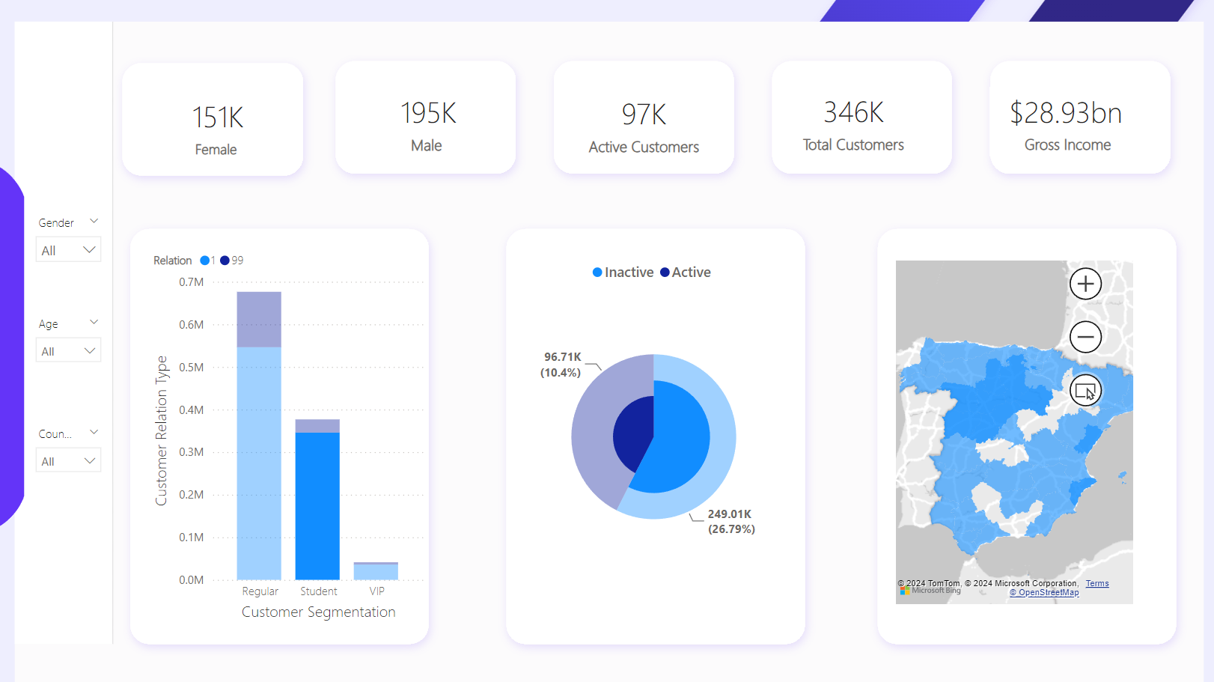
Showing interactivity

Slide 7
Key Performance Indicators (KPIs)
Female Customers: 505K
Male Customers: 425K
Active Customers: 395K
Total Customers: 930K
Gross Income: $94.08bn
Dashboard Overview
The dashboard provides an intuitive view of:
Customer Segmentation: This bar chart shows the distribution of customer types (Regular, Student, VIP) segmented by active and inactive customers.
Customer Activity: The pie chart visualizes the percentage of active vs inactive customers, giving a quick glance at the customer engagement.
Geographical Distribution: The map on the right highlights the spread of customers by region, providing insights into where most of the customer base is located.
Interactivity
The dashboard is fully interactive, allowing users to filter data dynamically using the slicers on the left:
Gender: Users can filter data based on gender.
Age: Allows slicing the data to see customer segmentation and activity patterns by age.
Country: Filters customers based on their country of residence.
Each slicer dynamically updates the KPIs and visualizations, enabling a comprehensive and user-friendly exploration of the dataset. By interacting with these slicers, you can observe changes in customer activity and gross income, providing insights to optimize cross-selling strategies.

Slide 8
Conclusion
This dashboard not only captures the KPIs effectively but also allows for dynamic data exploration, making it a powerful tool for visualizing customer segmentation and activity in real time. The interactivity and design allow users to drill down into specifics and make data-driven decisions.

